Slide 1
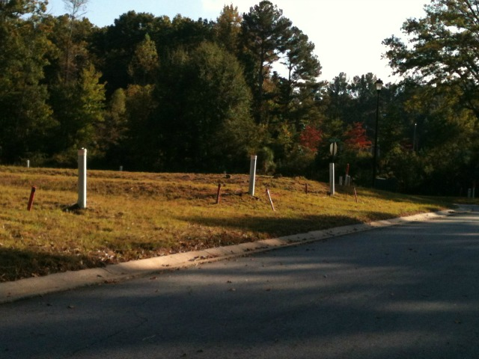
The Pipe Farms of DeKalb County
"A lot of these areas, I'm telling people, will never come back. They'll turn into ghost towns. Ghost developments.“
- Steve Palm of Smart Numbers, LLC on Atlanta’s Unfinished Subdivisions

Slide 2
Objectives
Strategy for DeKalb County Pipefarms
Neighborhood Revitalization
Stimulate development increasing tax base and county revenues
Attract community investment
Improve community aesthetics

Slide 3
Strengths
Seller profile has shifted back to favorable proportions
2010: Foreclosures / Short Sales = 60%
2013: Foreclosures / Short Sales = 40%
Supply continues to shrink
Most markets supply down over 30% from last year
Values remain below the historical trend line
Peak in 2007; trough in 2012
Interest rates remain below historical averages
Rates currently around 4%; historical around 8%
Opportunity to partner with organizations that have a similar mission

Slide 4
Challenges
Initiating Change
Resources
Organization
Marketing and Packaging to Developers
Perseverance

Slide 5
Atlanta Market Trends
Case Schiller Index
Atlanta home prices since 2007 declined 29%, however 2013 began with 4 consecutive months of increases and posted a 13% YOY increase, biggest since 1991
Permits – up 115% since 2011
Metro Study/FMLS Data
Only 3 month supply of new unsold homes on market, the lowest amount of inventory on record for Atlanta
8,288 new homes started during 2012, a 53% increase compared to 2011
During 4Q12 there were 2,265 new home starts, an 85% increase compared to 4Q11

Slide 6
Atlanta Market Trends
Currently the cost of owning exceeds the cost of renting
Trulia – Data indicates that Atlanta is 57% cheaper to buy versus renting. However if rents continue to rise and the market/economy continues to improve, those that can get a mortgage will choose to buy versus rent
In South Dekalb County study area
Supply – there is a 6 to 9 month supply of homes listed for sale between $150K and $200K (a 36 month supply for homes priced above $200K. Supply is based on trailing 1 year adsorption)
Demand - prices need to be closer to $150K

Slide 7
Recommendations
Public-Private Partnerships
Asset Management Program
Market Analysis
DeKalb County Redevelopment Roundtable
Other Incentives/disincentives (carrots/sticks)

